Slide 1


Securing Your Infrastructure with HCP Vault Secrets
This presentation explores HCP Vault Secrets, a critical tool for DevOps engineers and security professionals. We'll cover its features, use cases, and best practices for secure secret management.
by Vidhya Sudarsanan

Slide 2





HCP Vault Secrets: Core Use Cases
Static Secret Management
Centralize and retrieve key-value secrets securely.
Auto-rotating Secrets
Automate secret rotation on a schedule or on-demand.
Dynamic Secrets
Generate unique, short-lived credentials for each client.
Secrets Sync
Synchronize secrets to third-party platforms.
Workload Identity Federation
Eliminate long-lived credentials in configurations.

Slide 3
Auto-rotating vs. Dynamic Secrets
Shared Goal
Workflow Differences
Application Focus
Both aim to automate credential management. They scope down lifetime and blast radius.
Lifecycles differ significantly. Dynamic Secrets offer higher security. Auto-rotating Secrets are more resilient to outages.
We'll use "payments" application to illustrate examples. This simplifies comparisons of their usage.

Slide 4
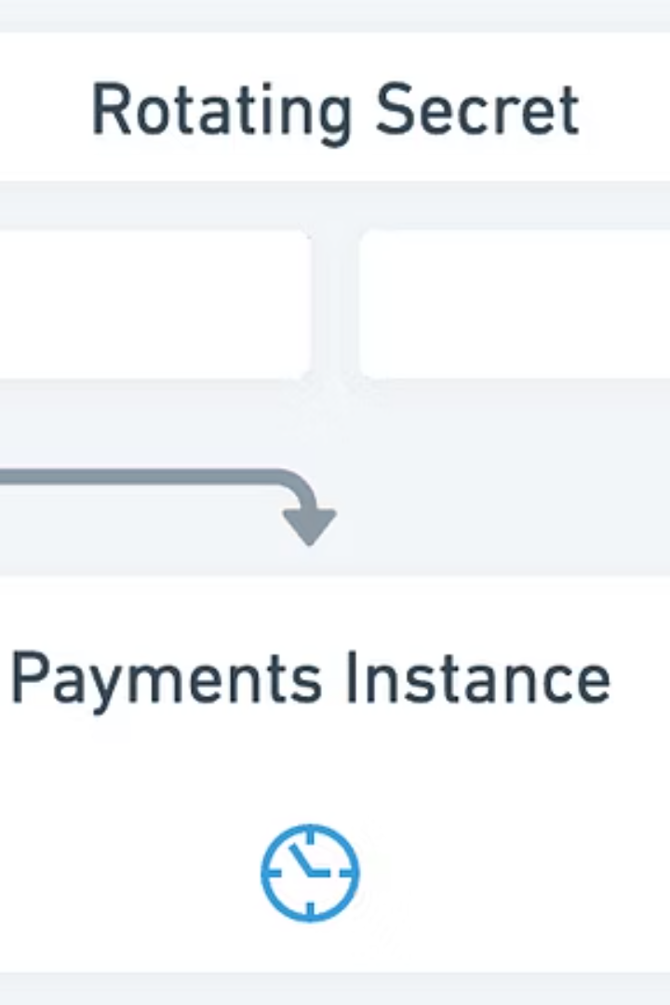



Understanding Auto-rotating Secrets
Scheduled Rotation
Secrets rotate on a background schedule. New credential becomes active.
Shared Access
Payments instances pull the latest secret. This secret is shared. It affects many instances if invalid.
Resilience and Auditing
Low latency, less error-prone retrieval. Existing credentials stay active during outages. Auditing historical values is easier.

Slide 5
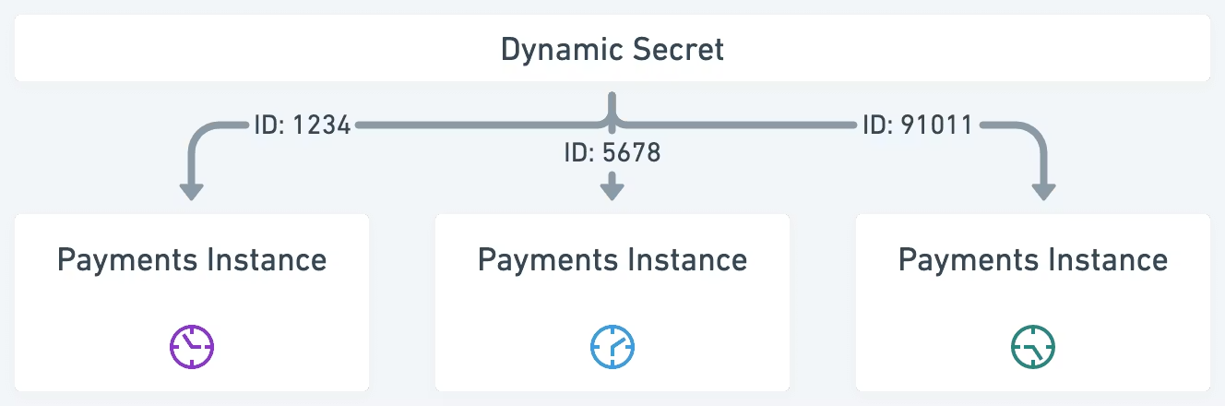
Understanding Dynamic Secrets
Just-in-Time Generation
1
Secrets are generated on demand. Each request gets a unique credential.
Isolated and Short-Lived
2
Credentials are isolated. They have shorter time-to-live. This enhances security.
Traceability
3
Leaked credentials are traceable. They link back to the specific instance. This aids forensic investigations.

Slide 6




Accessing Vault Secrets
CLI
UI
HTTP API
Command Line Interface offers fast, scriptable access. Ideal for automation and quick operations.
Web Interface provides a user-friendly graphical view. Easily browse secrets and manage settings.
RESTful API enables integration with custom applications. Essential for programmatic secret management.

Slide 7



Vault Initialization, Sealing, and Unsealing
Sealing
Vault starts in a sealed state. Secrets are inaccessible. This is a crucial security measure.
2
Initialization
First step after installation. Generates Unseal Keys (Shamir's Secret Sharing) and an Initial Root Token. Required for secure Vault usage.
1
Unsealing
Requires a quorum of unseal keys. Ensures no single person can access secrets. Maintains robust security posture.
3

Slide 8

HCP Vault Secrets: Constraints and Considerations
Secret Name Constraints
Secret Value Size
Between 1 and 64 characters. Must start with ASCII letter or '_'. Can contain ASCII letters, digits, or '_'. Allows environment variable injection via CLI.
Current character limit is 5120 characters per secret. Plan accordingly for large secret values.
Usage Limits
Refer to API rate and resource limits documentation. Understand these limits for optimal performance.

Slide 9

Managing Sync Integrations
1
Sync Structure
Composed of installations and integrations. Installations hold authentication details. Integrations contain sync configurations.
2
Integration Deletion
Can be done via UI or API. Deletes the specific sync configuration. Does not remove the underlying installation.
3
Installation Deletion
Only possible via the API. Removes authentication details. Affects all dependent integrations.

Slide 10

API Disconnection Bug & Workarounds
There is a known API bug where a PATCH request to edit an App's Description, without also passing the sync_integrations field, disconnects all sync integrations from the application. The integrations are not deleted, only disconnected.
Edit App's Description via UI or CLI.
Pass existing integrations in PATCH request body.
Reattach disconnected integrations with a second PATCH request.

